Slide 1
COMP 3100
Week 9 - Wednesday

Slide 2
Last time
What did we talk about last time?
Refactoring
TDD
System testing
  Alpha testing
  Beta testing

Slide 3
Questions?

Slide 4
Deployment, Maintenance, and Support

Slide 5
Deployment, maintenance, and support
The product has been designed, constructed, and tested…now what?
Users will actually use the product in the production environment, the hardware and software systems where the product lives
Making the product available in the production environment is called deployment
Help that the developer (or their associates) provide to the user is called support
Changes to the software after deployment are called maintenance

Slide 6
Physical architecture
Physical architecture is how the program lives in a file system and executes on processors
  As opposed to logical architecture, what we considered before
Physical architecture can be structured by where it's installed, where it's executed, and where the data it uses is stored
The following four categorizations are common:
  Personal: Software is installed and executed on a user device, where the data is
  Shared: Software is installed on a shared device and temporarily loaded on the user device where it is executed on user data
  Mainframe: Software is installed and executed on a shared device accessible from a user device (terminal) using data stored on the shared device
  Cloud: Software is installed on a shared device and temporarily loaded on the user device where it is executed using data stored on the shared device

Slide 7
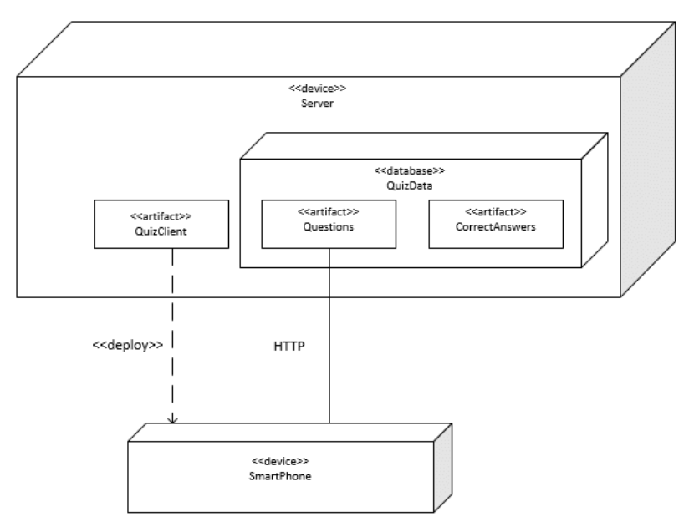
Modeling physical architecture
Like logical architecture, physical architectures can be modeled using UML
UML deployment diagrams contain artifacts and nodes
  Artifacts are physical components like files
    Represented as rectangles with the stereotype «artifact» or an icon
  Nodes are physical devices or execution environments like an operating system
    Represented as boxes with the stereotype «device», «execution environment», or some other description
  Communication between nodes is shown with a solid line
  The deployment relationship is show by putting the artifact in the node box, listing the artifacts in the node box, or using a dashed arrow with the stereotype «deploy»

Slide 8
Deployment
Deployment has the following steps
  Release: Assembling the artifacts into a distributable package (like a zip file or an installer tool)
  Install: Bringing the distributable package to the production environment and putting the artifacts in the right nodes
  Activate: Start the executable artifacts
Ideally, the installation and activation appear to be atomic
  They happen as if they are a single activity
  They can be rolled back to the state before the installation

Slide 9
Distribution channels
Distribution has changed over time
Once upon a time, someone with significant technical skill was needed to install software by hand
Later, executable installers could be bought on disk or downloaded from the Internet
Stores are now a common way to automatically install and update software
  Examples: Apple Store, Windows Store, Steam
Package managers are used for open source software
  Examples: apt, rpm, dpkg, yum
Containers like Docker are also used to provide software in a customized execution environment, ready to use

Slide 10
Maintenance
Maintenance is a change to software after it's been deployed
  Corrective maintenance: Changes that fix faults after they have given rise to failures
  Preventative maintenance: Changes that correct faults before they give rise to failures (or to improve other characteristics like portability)
  Adaptive maintenance: Changes that keep the product usable in a changing environment
  Perfective maintenance: Changes that satisfy additional functional or non-functional requirements
Since products are constantly changing in agile, it's not always clear what's maintenance and what's just another cycle of development

Slide 11
Cost of maintenance
Maintenance is expensive
  Some studies suggest that maintenance is responsible for 80% of the total effort surrounding a software product
  This is exactly why Microsoft pushes OS versions off the supported list as soon as it can
Maintenance is expensive for many reasons:
  It goes on for a long time, maybe decades
  Software is poorly written to begin with, and maintaining only gets harder if new features are added
  Software structure deteriorates over time as changes are made
  In traditional processes, maintenance can take a long time and still end up with a bad result
Agile processes overcome some of these issues by making maintenance a natural continuation of development

Slide 12
Support
Support are the activities between the user and a developer (or representatives of the developer) to help the user's experience
Support is often put into two categories
  Professional support: The person providing support is employed by or paid by the developer
  Community support: The person providing support is another user or expert not employed by the developer
Even professional support is usually not provided by the developers themselves
  Support teams usually have lower skills and are paid less
  Developers might not have the *ahem* interpersonal skills to deal with frustrated users
  Support teams often have better knowledge of the application domain (the thing the product is being used for)

Slide 13
Support communication
Support can come through synchronous communication channels like phone or chat
Or through asynchronous channels like e-mail or forums
Asynchronous channels are usually cheaper but lower quality
Like with bugs, support teams can use issue tracking systems to track and prioritize support issues
Support can be free or based on a fee
  Sometimes different levels of support are provided depending on the fee
Like maintenance, support can be a large part of the cost of a product and is sometimes neglected

Slide 14
Review

Slide 15
Exam format
The exam will have:
  Short answer questions
  At least one diagram
  Probably a JUnit test case or two to write
  Probably some matching
  One or two essay questions
Look at the point values to determine where to invest your time

Slide 16
Software Quality Assurance

Slide 17
Eight dimensions of software quality
Functional suitability
  How much the product satisfies user needs
Performance efficiency
  Processing time and resources used
Compatibility
  How well the product can co-exist and interoperate with other products
Usability
  How easy the product is to learn and use
Reliability
  The extent to which the product does certain functions under given conditions and recovers from interruptions
Security
  Confidentiality, integrity, authenticity, non-repudiation, and accountability
Maintainability
  How easy it is to modify, adapt, and reuse the product
Portability
  How easy it is to make the product work in a different computing environment

Slide 18
Quality assurance
Quality assurance (QA) is a system for making sure the product satisfies stakeholder needs
QA focuses on two distinct goals:
Validation
  Testing if the product satisfies stakeholder needs
  "Are we building the right product?"
  Example: Does the customer want steak and fries?
Verification
  Testing if the product satisfies needs properly
  "Are we building the product right?"
  Example: Are the steak and fries cooked well?

Slide 19
Defect prevention
There is no one way to prevent defects
Instead, preventing defects must be built into the software development processes that the entire organization uses
  Process improvement is making a process better
  Training and education are necessary
Process guides such as documentation standards and style guides help
Using well-studied design methodologies (such as OOP) can help

Slide 20
Reusing ideas
Reusing design architectures that have been successful in the past can prevent defects
  Examples: MVC and pipe-and-filter
Design patterns are standard patterns for OOP classes
  Examples: decorator and factory
Using well-studied algorithms and data structures helps a great deal
Reusing code (often from libraries) is smart, especially since those libraries have been tested thoroughly

Slide 21
Formal methods and prototypes
Formal methods include systems for mathematically checking that code does what it's supposed to
  Not all code can be modeled mathematically
  Yet some of these systems have found bugs in real software, such as TimSort, the most commonly used sort in Python and Java
Prototypes let us explore what defects might happen before putting them in the final product
  The opposite end of the spectrum from formal methods, since prototypes are practical rather than theoretical

Slide 22
Tools
Many tools help reduce defects
Version control tools help track code over time
Configuration management tools allow changes in one tool to automatically update other tools
  Examples: Puppet and Ansible
Integrated development environments (IDEs), once called computer aided software engineering (CASE) tools, can integrate many useful tools for defect prevention
  Syntax highlighting
  Two-way translation between code and UML models
  Style checking

Slide 23
Defect detection and removal
A good process can't keep out all defects
Some defects will show up and must be found and removed
Defect detection and removal techniques fall into two categories:
  Review and correct
  Test and debug
Review and correct methods look at the code while test and debug methods look at the product in operation

Slide 24
Review and correct methods
There's a formal name for just looking at your code for errors: a desk check
A walkthrough is when you explain your code to someone else
An inspection is a more formal process with trained inspectors
Inspection roles:
  Moderator schedules and runs the meeting and distributes the code
  Author of the code
  Reader who guides the meeting
  Recorder who takes notes
  Inspectors who check code before and during the meeting

Slide 25
Test and debug
Testing software helps find cases that are not obvious from looking at the code
Software testing has some jargon:
  A failure is a deviation between actual behavior and intended behavior
  A fault is a defect that can give rise to a failure
  A trigger is a condition that causes a fault to result in a failure
  A test case is a set of inputs and program states
  A collection of test cases is a test suite
Debugging is using trigger conditions to find and fix faults

Slide 26
Overview of testing
Unit Testing
Integration Testing
Alpha Testing
Beta Testing
Unit tests test a small piece of code (method or class) in isolation from other code
  Often done by the author
Integration tests test several small pieces of code together
  By the author, a testing team, or both
Alpha and beta tests test the whole product
  Alpha tests usually have a testing team
  Beta tests include users
System Testing

Slide 27
Breaking it all down
Defect Elimination
Defect Prevention
Process Guides
Analysis and Design Methods
Reference Architectures
Design Patterns
Data Structures and Algorithms
Software Reuse
Prototyping
Version Control
Configuration Management
IDE Tools
Training and Education
Defect Detection and Removal
Review and Correct
Style and Standards Checkers
Spelling and Grammar Checkers
Reviews
Desk Checks
Walkthroughs
Inspections
Test and Debug
Regression Testing
Unit Testing
Integration Testing
System Testing
Alpha Testing
Beta Testing

Slide 28
User Interaction Design

Slide 29
Interaction design
Interaction design is planning out the user experience (UX) for a software product
It cares about how the product looks and sounds (and, one day, smells?) and how the user gets output and puts input into it
This field used to get little attention from computer scientists, but it's really important
  Apple is a great posterchild for showing off the value of UX
  Even Microsoft, maligned for its user interfaces, has invested lots of money studying how to make windows and icons easier to use
UX is part of the field of human computer interaction (HCI), which combines ergonomics, physiology, psychology, and graphic design with computer science
The quality of a user interface is called its usability

Slide 30
User interaction design goals
Effectiveness: User can access all the features they need
Efficiency: Users can achieve their goals quickly
Safety: Users and computers aren't harmed
Learnability: Users become proficient quickly
Memorability: Users regain proficiency quickly after time away from the product
Enjoyability: Users experience positive emotions when using the product
Beauty: Users find the product aesthetically pleasing

Slide 31
Interaction design models
Before coding the UX, models are incredibly helpful to plan out how it looks and behaves
Static interaction design models show the audio and visual parts of the product that don't change during execution
Dynamic interaction design models show behavior during execution
Both are useful

Slide 32
Use case diagrams
A use case is an interaction between a product and its environment
An actor is an agent that interacts with a product
Use case diagrams (which we've seen before) are static interaction design models that represent the actors that interact with use cases

Slide 33
Layout diagrams
Screen layout diagrams and page layout diagrams are drawings of a product's visual display
A wireframe is a low-fidelity version that gives a rough layout without a lot of detail
It's good to start with a wireframe and refine it with more detail later

Slide 34
Use case descriptions
A use case diagram shows which actors interact with use cases
However, it doesn't explain what they do
A use case description is formatted text that explains the actions that an actor makes
The use case description is a dynamic interaction design model
Example template:
Use Case Name | To identify the use case
Actors | The agents participating in the use case
Stakeholders and Needs | What this use case does to meet stakeholder needs
Preconditions | What must be true before this use case begins
Post conditions | What will be true when this use case ends
Trigger | The event that causes this use case to begin
Basic Flow | The steps in a typical successful instance of this use case
Extensions | The steps in alternative instances of this use case due to variations in normal flow or errors

Slide 35
SAC principles
Design principles favor certain characteristics to make a design better
SAC principles are three general interaction design principles
Simplicity
  Simple designs are better
  Lots of options are confusing for the user
  It's better to make commonly used options easy and require a little more work for unusual options
Accessibility
  Designs that can be used be more people are better
  Considerations: color blindness, things too small to see or interact with
Consistency
  Designs that present data in similar ways are better
  Example: use consistent navigation controls

Slide 36
CAP principles
CAP principles are focused on appearance
Contrast
  Designs that make different things obviously different are better
  Example: italics and bold
  Example: font size to distinguish headings from text
Alignment
  Designs that line up on a grid are better
  Indentation is useful
Proximity
  Designs that group related things together are better

Slide 37
FeVER principles
FeVER principles are about behavior
Feedback
  Designs that acknowledge user actions are better
  Otherwise, how do you know if what you're doing has an effect?
Visibility
  Designs that display their state and available operations are better
  Are we in Arm Bomb or Disarm Bomb mode?
Error Prevention and Recovery
  Designs that prevent user errors and allow error recovery are better
  Prevention example: disable buttons that shouldn't be pressed
  Recovery example: allow undo or ask "Are you sure?" before doing something dangerous

Slide 38
Software Engineering Design

Slide 39
Preventing design defects
A number of approaches can be used to avoid design defects
Design principles: Using a list of good principles helps you make good choices
Design notations: Using good notations (often UML diagrams) helps designs be complete and consistent
Design processes: Using established processes for designs helps avoid mistakes
Design patterns: Using patterns, models designed to be imitated, reuses solutions that have worked in the past (and make design easier)

Slide 40
Simplicity
As with interface design, simpler designs are better
What is simplicity?
  Fewer lines of code
  Fewer control structures
  Fewer connections between different parts
  Fewer computations with different kinds of objects
A good rule of thumb is which design is easiest to understand
Simplicity is a good goal, but some important algorithms in computer science are necessarily complex
Everything should be made as simple as possible, but not simpler.
-Attributed to Albert Einstein, who probably did not say it quite like that

Slide 41
Small modules
Designs with small modules are better
Smaller modules are easier to read, to write, to understand, and to test
Miscellaneous guidelines:
  Classes should have no more than a dozen operations (methods)
  Classes should be no more than 500 lines long
  Operations should be no more than 50 lines long
  I have heard that you should be able to cover a method with your hand
Of course, it is often impossible to follow these guidelines

Slide 42
Information hiding
Each module should shield the internal details of its operation from other modules
Declare variables with the smallest scope possible
Use private (and protected) keywords in OOP languages to hide data (and even methods) from outside classes
Advantages of information hiding:
  Modules that hide their internals can change them without affecting other thins
  Modules that hide information are easier to understand, test, and reuse because they stand on their own
  Modules that hide information are more secure and less likely to be affected by outside errors
This is why we use mutators and accessors instead of making members public

Slide 43
Minimize module coupling
Module coupling is the amount of connectivity between two modules
Modules can be coupled in the following ways:
  One class is an ancestor of another class
  One class has a member whose type is another class
  One class has an operation (method) parameter whose type is another class
  One operation calls an operation on another class
If there two modules have many of these couplings, we say that they are strongly coupled or tightly coupled
When modules are strongly coupled, it's hard to use them independently and hard to change one without causing problems in the other
Try to write classes to be as general as possible instead of tied to a specific problem or set of classes
Using interfaces helps

Slide 44
Maximize module cohesion
Module cohesion is how much the stuff in the module is related to the other stuff in the module
We want everything in a class to be closely related
It's best if a class keeps the smallest amount of information possible about other classes
More module cohesion usually leads to looser module coupling
Sometimes a module being hard to name suggests that its data or operations are not cohesive

Slide 45
Design process
Design Problem
Analyze Design Problem
The design process is a microcosm of the larger software development process
The steps are analyzing the problem, proposing solutions (and looking up existing solutions to similar problems), and evaluating the solutions (perhaps combining different solutions) until a design is selected
Generate and Improve Candidate Designs
Evaluate Candidate Designs
Select Design
Inadequate
Adequate
Design Specification
Finalize Design

Slide 46
Architectural design
Architectural design is specifying a program's major components
Architectural design is often modeled with a box-and-line diagram (also called a block diagram)
  Components are boxes
  Relationships or interactions between them are lines
  Unlike UML diagrams, box-and-line diagrams have no standards
  Draw them in a way that communicates your design

Slide 47
Model-View-Controller
The Model-View-Controller (MVC) style fits many kinds of web or GUI interactions
The model contains the data that is being represented, often in a database
The view is how the data is displayed
The controller is code that updates the model and selects which view to use
The Java Swing GUI system is built around MVC
Good: greater independence between data and how it's represented
Bad: additional complexity for simple models

Slide 48
Layered style
Organize the system into layers
Each layer provides services to layers above it, with the lowest layer being the most fundamental operations
Layered styles work well when adding functionality on top of existing systems
Good: entire layers can be replaced as long as the interfaces are the same
Bad: it's hard to cleanly separate layers, and performance sometimes suffers

Slide 49
Repository style
If many components share a lot of data, a repository style might be appropriate
Components interact by updating the repository
This pattern is ideal when there is a lot of data stored for a long time
Good: components can be independent
Bad: the repository is a single point of failure

Slide 50
Client-server architecture
Client-Server styles are used for distributed systems
Each server provides a separate service, and clients access those services
Good: work is distributed, and clients can access just what they need
Bad: each service is a single point of failure, and performance might be unpredictable

Slide 51
Pipe and filter style
In the pipe and filter style, data is passed from one component to the next
Each component transforms input into output
Good: easy to understand, matches business applications, and allows for component reuse
Bad: each component has to agree on formatting with its inputs and outputs

Slide 52
Project Scheduling

Slide 53
Project scheduling
Project scheduling is organizing the work
  Into separate tasks
  When the tasks will be done
  Who will do them
Both waterfall and agile approaches benefit from scheduling
  For waterfall, all tasks in the project are scheduled
  For agile, there might be an overall schedule for when major phases of the project will be completed
Tasks should last at least a week but not more than two months
  A task taking more than two months should be broken into subtasks
It's helpful to have visualizations of these tasks

Slide 54
Example of tasks
This table shows all the task information, but it's hard to visualize
M is used to label milestones
Task | Effort (person-days) | Duration (days) | Dependencies
T1 | 15 | 10
T2 | 8 | 15
T3 | 20 | 15 | T1 (M1)
T4 | 5 | 10
T5 | 5 | 10 | T2, T4 (M3)
T6 | 10 | 5 | T1, T2 (M4)
T7 | 25 | 20 | T1 (M1)
T8 | 75 | 25 | T4 (M2)
T9 | 10 | 15 | T3, T6 (M5)
T10 | 20 | 15 | T7, T8 (M6)
T11 | 10 | 10 | T9 (M7)
T12 | 20 | 10 | T10, T11 (M8)

Slide 55
Gantt charts
Gantt charts show the same information, but in a much clearer way
  Bars shows the length of each task
  Dependencies are shown by the starting point of each task
Recall that you made a Gantt chart for Project 2
For it, you needed to break down your product into tasks and figure out which tasks are dependent on which

Slide 56
Detailed Design

Slide 57
More depth on class diagrams
Class diagrams are made up of class symbols (rectangles)
These class symbols contain one or more compartments
The top compartment has the class name
A second, optional compartment often contains attributes (called member variables in Java classes)
  Often followed by a colon with the type
A third, optional compartment often contains operations (called methods in Java classes)
  Sometimes followed by parameter and return types
Visibility modifiers can be marked:
  + for public
  # for protected
  ~ for package
  - for private
Only important attributes and operations need to be specified
  Classes might contain others that aren't shown

Slide 58
Inheritance and interfaces in class diagrams
Inheritance is shown with the generalization connector
  A solid line from the child class to a solid triangle connected to the parent class
  Confusingly, this means that children classes point at their parent classes
Interfaces look like classes but are marked with «interface» above the class name
  This kind of marking is called a stereotype
  Stereotypes show extra information that wasn't part of the original UML class diagram specification
Classes that implement interfaces have dashed lines leading to a solid triangle connected to the interface

Slide 59
Other associations
Associations are show with lines between classes
  Associations can be labeled to explain them
  The lines can be marked with the multiplicity, showing how many of each class can be associated with the other
  The multiplicity can be comma separated lists or ranges, and * means zero or more
When a class is part of another class, the part is connected by a line and a diamond (the aggregation connection) to the whole

Slide 60
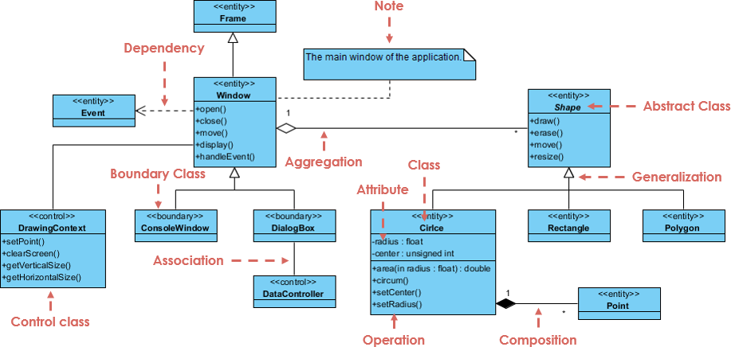
Complex example
From visual-paradigm.com

Slide 61
Design Patterns

Slide 62
Design patterns
Software design patterns are ways of designing objects that have been used successfully in the past
  Think of them as rough blueprints or guidelines
Design patterns have four essential elements:
  A meaningful name
  A description of the problem area that explains when the pattern may be applied
  A solution description of the parts of the design, their relationships, and their responsibilities
  A statement of the consequences of using the design pattern
Patterns are more abstract than code

Slide 63
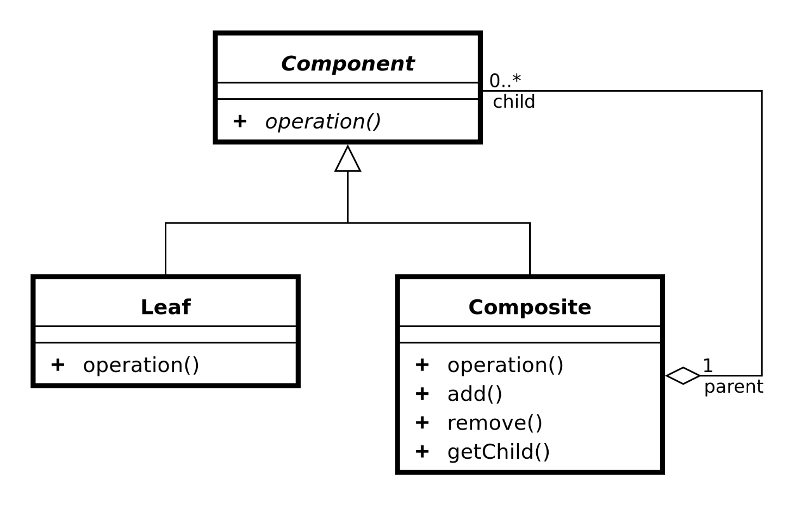
Composite pattern
The composite pattern is useful for part-whole hierarchies of objects
A group of objects somewhere in the hierarchy can be treated like a single object
The Swing library uses the composite pattern for its graphical components
Problems the composite pattern solves:
  Representing a part-whole hierarchy so that clients can treat parts and wholes the same
  Representing a part-whole hierarchy as a tree

Slide 64
Command pattern
The command pattern is useful for encapsulating an action in an object
The action is independent from the objects that used it and can be stored for later
The Swing library uses the command pattern for events
Problems the command pattern solves:
  Decoupling the requester from a request

Slide 65
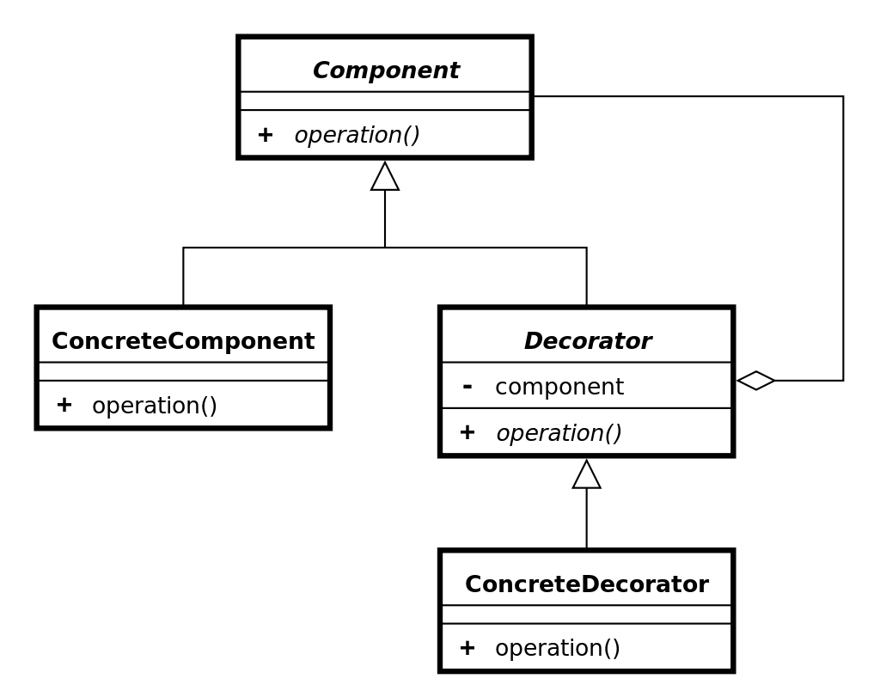
Decorator pattern
The decorator pattern provides a way to add responsibilities to an object dynamically at run-time
It is commonly used to customize the appearance of GUI elements
The Swing library uses the decorator pattern to customize borders
Problems the decorator pattern solves:
  Adding responsibilities to an object dynamically at run-time
  Providing a flexible alternative to inheritance for extending functionality

Slide 66
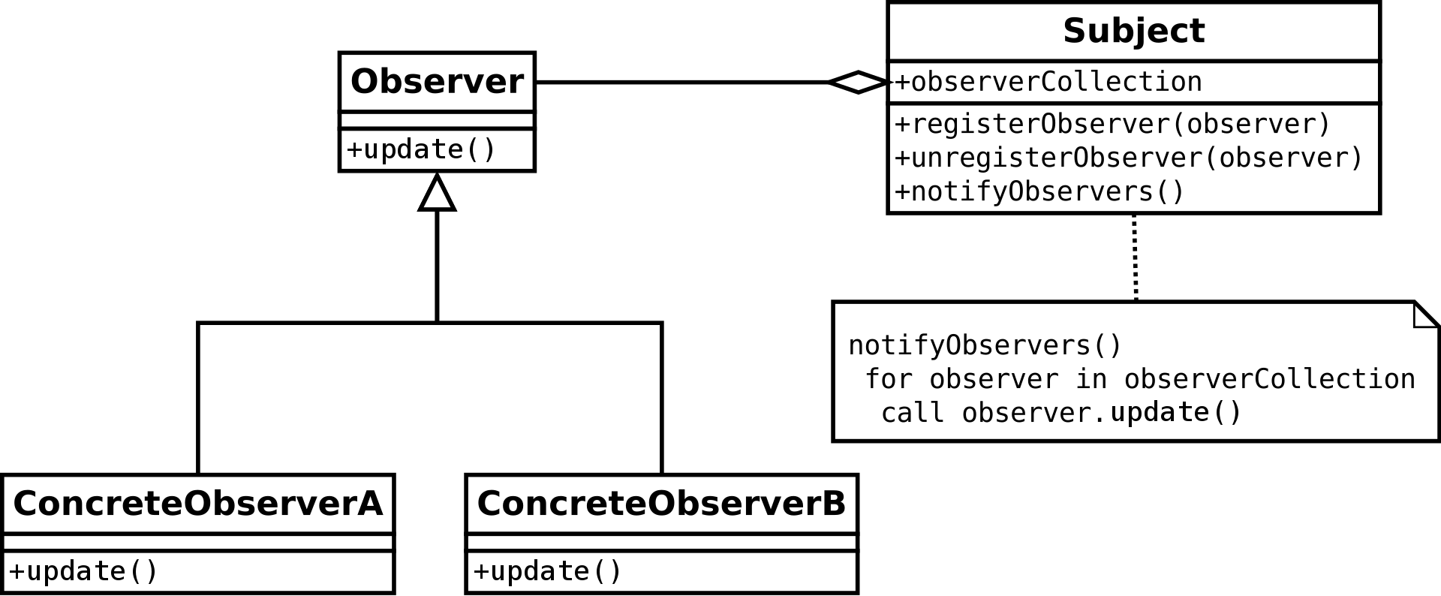
Observer pattern
The observer pattern is useful for a one-to-many dependency where one object changing can update many other objects
An observer pattern defines Subject and Observer objects
When a subject changes state, registered observers are updated automatically
Problems the observer pattern solves:
  Making a one-to-many dependency between objects without tightly coupling the objects
  Updating an arbitrarily large number of other objects automatically when one object changes state

Slide 67
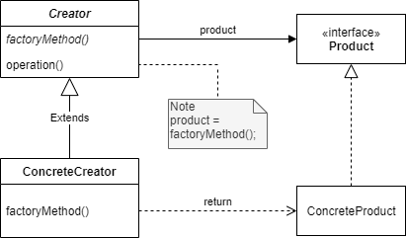
Factory method pattern
The factory method design pattern allows a method to be overridden so that a child class can determine what kind of object to create
A factory method is defined that is used to create objects
Problems the factory method pattern solves:
  Allowing subclasses to define which class to instantiate

Slide 68
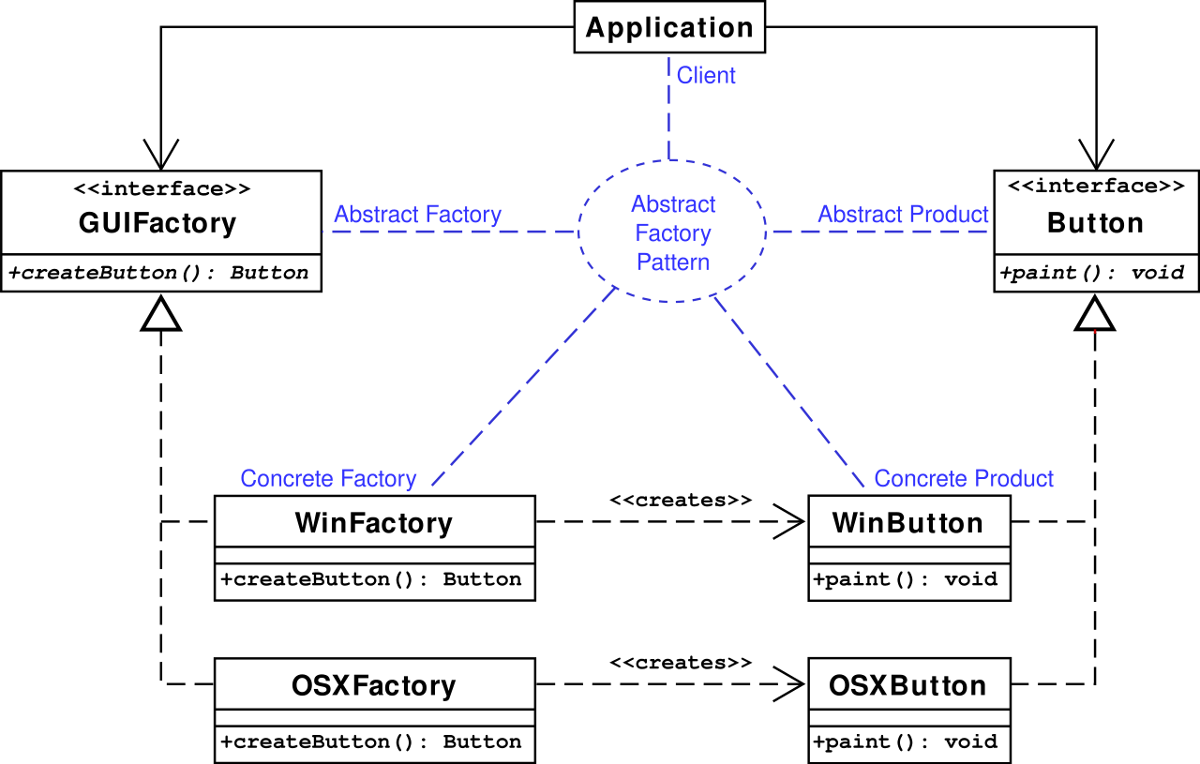
Abstract factory pattern
The abstract factory pattern is similar except that it uses some object as a factory instead of overriding a method
Problems the abstract factory pattern solves:
  Making a class be independent of the objects it requires
  Making a family of related objects

Slide 69
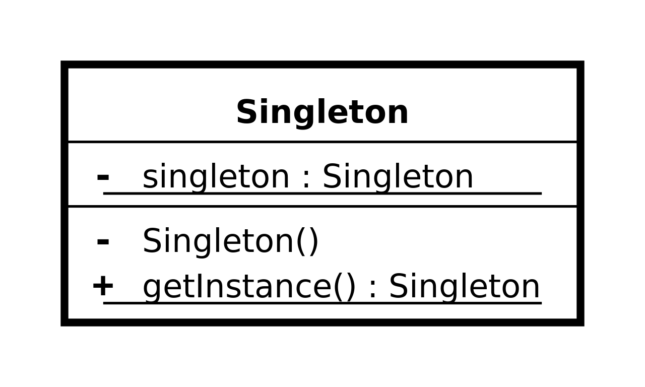
Singleton pattern
Sometimes it's useful to have only a single instance of a class
The singleton pattern makes it so that it's possible to make only one object of a class and makes it easy to access
Problems the singleton pattern solves:
  Ensuring that there's only one instance of a class
  Making the instance of a class easy to get

Slide 70
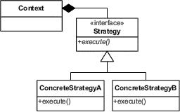
Strategy pattern
The strategy pattern allows an algorithm to be selected at run-time
In Java, that algorithm is usually encapsulated in the method of an object
Problems the strategy pattern solves:
  Configuring a class with an algorithm at run-time
  Selecting or exchanging an algorithm at run-time

Slide 71
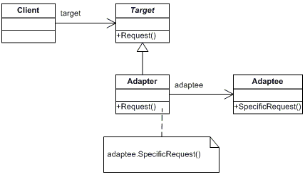
Adapter pattern
Sometimes you have an object that doesn't generate the right kind of output
The adapter pattern allows you to turn the output from something that gives one kind of output into the kind you need
Problems the adapter pattern solves:
  Reusing a class that doesn't have an interface the client requires
  Allowing classes with incompatible interfaces to work together

Slide 72
Construction Techniques

Slide 73
Bought and customized systems
It's not always necessary to build a system from scratch
A bought and customized system is one with several bought subsystems that have been customized and integrated into a product that satisfies requirements
These systems come in a number of overlapping categories:
  Commercial off-the-shelf (COTS) systems are generic products (like SAP, SalesForce, or Blackboard) that need significant customization for a particular client
  Component-based systems are constructed from individual objects that use standard interfaces, like Java Beans and .NET
  Service-oriented systems are like component-based systems except that the connection between components is over the network, and the services are provided by servers

Slide 74
Pros and cons of bought and customized systems
Pros:
  Widely used components are usually reliable
  Good documentation and standards exist for using such components
  Constructing these systems is usually faster, and costs are easier to predict
Cons:
  Increased dependency on outside organizations and their support
  Lowered flexibility
  Software engineers have less creative control, potentially reducing job satisfaction (boohoo)

Slide 75
Idioms
Idioms in programming languages are common ways to express ideas
Example Java idioms:
  Use for loops when you want to repeat a specific number of times
  Use while loops when you don't know how much you're going to repeat
  Use a three-line swap to exchange values
It's a good idea to read code in a language you don't know well to figure out the idioms that people use
Some people use idioms from languages they know better that can be either inefficient or confusing if they're not used in a different language
Syntactic sugar is a kind of formalized idiom
  An easy-to-use grammatical structure is converted to a harder-to-read one behind the scenes
  Example: enhanced for loops in Java

Slide 76
Programming style
Each language has stylistic considerations for how to write readable code
  Many workplaces and open source projects publish style guidelines
Naming conventions cover how to name variables, methods, classes, files, packages, etc.
  Spelling matters
  Capitalization is often a matter of convention
  Being consistent makes everything clearer

Slide 77
Naming
Most languages encourage either snake case or camel case
  Snake case breaks up words with underscores: nuclear_silo_radius
  Camel case breaks up words with capitalization: nuclearSiloRadius
  Snake case is common in C and Python
  Camel case is common in Java and C#
  Very few programming languages allow spaces in variable names
I prefer variables to be explicit so that it's clear what we're talking about even if we start reading in the middle of unfamiliar code
  Java tends toward the explicit rather than the abbreviated
A few other Java naming conventions:
  Packages are all lowercase
  Local variables, member variables, and methods start with lowercase letters
  Classes, enums, and interfaces start with uppercase letters
  Constants are written in snake case with ALL CAPS

Slide 78
Older naming conventions
Most languages do not have meaningful limitations on variable name length now, but they used to
Older C code in particular often leaves out vowels to save space
Hungarian notations are naming conventions that describe the types of variables with prefixes:
  wParam (word-sized parameter)
  pfData (pointer to a floating-point value of data)
  lpszName (long pointer to a zero-terminated string)
Hungarian notations can also be used to specify scopes:
  g_nGoats (global integer for number of goats)
  m_nBoats (member variable integer for number of boats)
These conventions have largely been given up, since IDEs provide tools for keeping track of types and scopes
  Also, languages likes Java and C# have much stronger type-safety than C and C++, giving compiler errors for misusing types

Slide 79
Layout conventions
Many languages (with the notable exception of Python) ignore whitespace
Thus, we have a choice about how to layout our code
In C-family, curly brace languages, it's common to put the opening brace of an if statement, method, or loop either on the same line as the header (K&R style) or on the next line (Allman style)
  K&R is more common for Java, but Allman is more common for C#
Some people also have strong feelings that indentation should be tabs while others prefer spaces
A common convention is that lines of code should not exceed 80 characters
K&R style
if (raining) {
System.out.println("I'm wet!");
}
Allman style
if (raining)
{
System.out.println("I'm wet!");
}

Slide 80
Commenting
Almost every language allows for comments
Code that is so easy to understand that it needs no comments is called self-documenting code
  Ideally, all code is self-documenting, but this goal is rarely reached
Perhaps the other end of the spectrum is literate programming, which explains everything in English mixed in with the code, taking the perspective that code is for humans to understand and only incidentally for computers to execute
Commenting should explain confusing code, especially unusual algorithms

Slide 81
Good commenting
Do use comments to describe the intent of a complicated piece of code
Do use comments to explain the rationale behind a decision so that people can understand in the future
  Why this way?
  Why not that other way?
Do use comments to reference relevant outside documents
  Explanation of an algorithm
  API documentation page
  Design document with UML diagrams

Slide 82
Questionable commenting
Don't use comments to repeat the code
Be careful about using comments for to-do items and future work
  Especially if it means you don't do the right thing now
It is possible to over-comment, so consider whether the supplemental information is useful
Bad comments that repeat the code
// Increase i by 1
++i;
// Include sales[i] in the total
total = total + sales[i];

Slide 83
Data organization
Programs often include data, but how should it be organized?
Data structures store the data in the program, but the data also needs to be stored between program runs or sent to someone else to use
  Internal data vs. external data
Common data organization approaches
  Markup languages
  Databases

Slide 84
Version control
We already know the value of a version control system (VCS)
Some details:
  A VCS stores items (usually files)
  A version is the set of items after one or more modifications
  A revision is a version stored in a VCS
  A baseline is the first revision
  Storage for revisions is called a repository
  Storing a version in the repository is called checking in or committing
  Retrieving a version from the repository is called checking out or updating
  A checked-out version of an item is a working copy

Slide 85
VCS choices
How do we deal with two or more different people working on the same file and trying to commit them to the same repository?
  File locking: When a files are checked out for modification, they are locked, meaning that no one else can check them out for modification
  Concurrent modification and merge: If someone tries to commit a file based on an older version of the file, the commit fails, forcing the person to merge the newer repository file with the file they're working on
Before you start modifying a file, it's wise to pull down the latest changes first
A centralized VCS has one central repository
A distributed VCS has many repositories that are peers

Slide 86
Quality Assurance in Construction

Slide 87
Static analysis and dynamic analysis
Static analysis is looking at code without running it
  Code reviews
  Syntax checking
  Style checking
  Usage checking
  Model checking
  Data flow analysis
  Symbolic evaluation
Dynamic analysis is running code to test it
  Unit testing
  Debugging
  Performance optimization and tuning
Both static and dynamic analysis are valuable and have different strengths
  Static analysis doesn't require a fully working program
  Dynamic analysis can give real data about things like performance

Slide 88
Code reviews
Desk checking is one form of code review
  Looking over the code
  Executing it by hand (actually computing values)
Formal inspections (discussed earlier) are another
Formal review guidelines
  Don't read more than 200 lines of code per hour when preparing alone
  Don't cover more than 150 lines of code when doing a team inspection
  Use a checklist
Examples from a Java inspection checklist
  All variables and constants are named in accord with naming conventions
  There are no variables or attributes with confusingly similar names
  Every variable and attribute has the correct data type
  Every method returns the correct value at every return point
  All methods and attributes have appropriate access modifiers (private, protected, or public)
  No nested if statements should be converted into a switch statement
  All exceptions are handled appropriately

Slide 89
Syntax and style checking
Syntax checking is now mostly done by editors and IDEs
Be careful about the errors and warnings IDEs and compilers given
  As computers, they can only guess about why the syntax is wrong
Language-specific style guides are required on most projects
Automated style checkers also exist
  In addition to formatting, they can check semantic issues like variables that are declared and not used
  Some features like this are included in modern compilers as warnings

Slide 90
Usage checking and idiom checking
For broader semantic issues, usage and idiom checkers (which can be combined with a style checker) look for:
  Suspicious or error-prone constructs
  Non-portable constructs
  Memory allocation inconsistencies
  Language-specific issues
    Loops that never execute
    Loops that never terminate
    Using types together that are legal but unusual

Slide 91
Formal methods
Formal methods use mathematical models to do static analysis
Model checking uses analysis to determine if a program meets requirements, usually if certain preconditions are met, it's guaranteed that certain postconditions will be met
Data flow analysis represents a program as a graph and uses that knowledge to calculate the possible values at various points in the graph
  Modern languages like Java use data flow analysis to complain, for example, that a variable might not have been initialized
Symbolic evaluation traces through the execution of a program with symbolic values instead of concrete values

Slide 92
Unit Testing

Slide 93
Unit testing
Testing is an important form of dynamic analysis
Unit testing is testing individual units or sub-programs (classes or methods in Java) in isolation
A test case has one value for every input and an expected value for every output
A false negative happens when there's a problem with your code but you don't write a test that catches it
  This almost always happens, since it's very hard to test everything
A false positive happens when your code is fine but your test is bad
  For example, you did the math wrong when coming up with your expected answer

Slide 94
Developing test cases
Picking good test cases is an art form
Black box testing is a strategy that assumes no knowledge of what happens inside the system
  Only what the input and matching output should be are known
  Black box testing is easily done by someone who had nothing to do with developing the code
  Black box testing isn't affected by assumptions about how an algorithm should work
Clear box (or white box or open box) testing uses knowledge of the system to generate good tests
Both kinds of testing are needed to be thorough

Slide 95
Code coverage
Clear box testing is built around the idea of coverage, which is how much of the unit is tested
Coverage can be explore with a control-flow graph (CFG) that shows the possible paths execution could take in a program
  An action node in a CFG is straight-line code with one entry point and one exit point
  A decision node in a CFG is code like an if statement or a loop with multiple exit points
  Arrows show the flow of execution through nodes

Slide 96
Example CFG
calculate(int x, int y)
S1
[else]
S2
[x > y]
int calculate(int x, int y)
{
int a, b;
a = 1; // S1
if (x > y) // S2
{
a = 2; // S3
}
x++; // S4
b = y * a; // S5
if (y <= 0) // S6
{
b++; // S7
}
return b; // S8
}
S3
S4
S5
[else]
S6
[y <= 0]
S7
S8

Slide 97
Kinds of coverage
We say a statement is exercised by a test or a suite of tests if it gets executed
Statement coverage is the percentage of statements exercised by a set of tests
  Example: (x = 1, y = 2) exercises everything except S3 and S7 in the previous CFG, giving a statement coverage of 75%
Branch coverage is the percentage of branch directions taken by a set of tests
  Example: (x = 1, y = 2) covers the else edge from S2 and the else edge from S6, giving a branch coverage of 50%
Path coverage is the percentage of all execution paths that have been taken
  Example: (x = 1, y = 2) takes only one of the four paths from S1 to S8, giving a path coverage of 25%
More coverage is better
It will usually take many tests to get good coverage

Slide 98
Boundary value analysis
Boundary value analysis uses values near the edges of legal limits
  If input must be within a range, create tests just below, at, and just above the endpoints of the range
  If output must be in a certain range, try to pick inputs that generate values around the minimum and maximum of that range
Example: Boundary values for a method that's supposed to accept passwords if they're between 6 and 12 characters inclusive
Input | Length | Case | Valid
"goats" | 5 | Mininum – 1 | False
"wombat" | 6 | Minimum | True
"wombats" | 7 | Minimum + 1 | True
"abracadabra" | 11 | Maximum – 1 | True
"hippopotamus" | 12 | Maximum | True
"administrator" | 13 | Maximum + 1 | False

Slide 99
Other heuristics
A number of other heuristics are commonly used because they often find errors
For single input parameters
  0 (because people forget about 0 or because of division by 0)
  Very large and very small numbers (because of underflow and overflow)
  Character or string versions of numbers (which makes sense in a language like Python or JavaScript but not in Java where type checkers would prevent such thins)
For multiple input parameters
  Equal values for the parameters
  Different relative values (x larger than y, then x smaller than y)
For arrays and collections
  Very small and very large arrays and collections
  Arrays or collections of length 0 and 1
  Arrays or collections that are unsorted, ascending, and descending
  Arrays or collections with duplicated values and with no duplicated values

Slide 100
Regression testing
Something's wrong with your program, so you change your code, what happens?
Data suggests that
  30% of software changes result in one of the three bad outcomes
  On average, bad outcomes occur about 10% of the time
  Faults introduced during bug fixes are harder to find and remove than others
One safeguard is regression testing, running all tests after any software change
  Any time you find a bug, add the test you used to find the bug into your test suite
 | No New Fault Introduced | New Fault Introduced
Fault Corrected | Good | Bad
Fault Not Corrected | Bad | Very Bad

Slide 101
Unit testing tools
Nowadays, running large test suites can be automated
Tools such as JUnit and other testing tools allow us to:
  Write clearly marked tests with special set-up and clean-up code if needed
  Run the tests, sometimes with randomized values or in randomized orders
  Record which tests pass and fail
  Show coverage information to see which lines of code the tests covered

Slide 102
JUnit
JUnit is a popular framework for automating the unit testing of Java code
JUnit is built into Eclipse and many other IDEs
It is possible to run JUnit from the command line after downloading appropriate libraries
JUnit is one of many xUnit frameworks designed to automate unit testing for many languages
You are required to make JUnit tests for Project 3
JUnit 5 is the latest version of JUnit, and there are small differences from previous versions

Slide 103
JUnit classes
For each set of tests, create a class
Code that must be done ahead of every test has the @BeforeEach annotation
Each method that does a test has the @Test annotation
import org.junit.jupiter.api.*;
public class Testing {
private String creature;
@BeforeEach
public void setUp() {
creature = "Wombat";
}
@Test
public void testWombat() {
Assertions.assertEquals("Wombat", creature, "Wombat failure");
}
}

Slide 104
Assertions
An assertion is something that must be true in a program
Java (4 and higher) has assertions built in
You can put the following in code somewhere:
If the condition before the colon is true, everything is fine
If the condition is false, an AssertionError will be thrown with the message after the colon
Caveat: The JVM normally runs with assertions turned off, for performance reasons
You have to run it with assertions on for assertion errors to happen
You should run the JVM with assertions on for testing purposes
String word = "phlegmatic";
assert word.length() < 5 : "Word is too long!";

Slide 105
Assertions in JUnit tests
When you run a test, you expect to get a certain output
You should assert that this output is what it should be
JUnit 5 has a class called Assertions that has a number of static methods used to assert that different things are what they should be
  Running JUnit takes care of turning assertions on
The most common is assertEquals(), which takes the expected value, the actual value, and a message to report if they aren't equal:
  assertEquals(int expected, int actual, String message)
  assertEquals(char expected, char actual, String message)
  assertEquals(double expected, double actual, double delta, String message)
  assertEquals(Object expected, Object actual, String message)
Another useful method in Assertions:
  assertTrue(boolean condition, String message)

Slide 106
Assertion example
We know that the substring() method on String objects works, but what if we wanted to test it?
import org.junit.jupiter.api.*;
public class StringTest {
@Test
public void testSubstring() {
String string = "dysfunctional";
String substring = string.substring(3,6);
Assertions.assertEquals("fun", substring, "Substring failure!");
}
}

Slide 107
Sometimes failing is winning
What if a method is supposed to throw an exception under certain conditions?
It should be considered a failure not to throw an exception
The Assertions class also has a fail() method that should never be called
import org.junit.jupiter.api.*;
public class FailTest {
@Test
public void testBadString() {
String string = "armpit";
try {
int number = Integer.parseInt(string);
Assertions.fail("An exception should have been thrown!");
}
catch(NumberFormatException e) {}
}
}

Slide 108
Debugging

Slide 109
Debugging
Debugging is using trigger conditions to identify and correct faults
Steps of debugging
  Stabilize: Understand the symptom and trigger condition so that the failure can be reproduced
  Localize: Locate the fault
    Examine sections of code that are likely to be influenced by the trigger
    Hypothesize what the fault is
    Instrument sections of code (with print statements or conditional breaks)
    Execute the code, monitoring the instrumentation
    Prove or disprove the hypothesis
  Correct: Fix the fault
  Verify: Test the fix and run regression tests
  Globalize: Look for similar defects in the rest of the system and fix them

Slide 110
Debug code
Debug code is temporary output and input used to monitor what's going on in the code
Instead of printing out just numbers, add context information so that the debug statements are clear
Debug code is quick and dirty, useful when setting break points and tracing execution with a debugger might be too much work to catch a small issue
There are logging tools that can print logging data at various levels
  Normally, nothing prints out
  Running the program in logging mode prints out important data
  Running the program in verbose mode prints out everything it can
Debug output can go to stdout or stderr
  System.err (instead of System.out) prints to stderr in Java

Slide 111
Debuggers
IntelliJ, Eclipse, Visual Studio, gdb and most fully-featured IDEs provide debugging tools
Typical debugging features:
  Setting breakpoints that will pause execution of the program when reached
    Breakpoints can often be conditional, pausing only if certain conditions are met
  Executing lines of code one by one, stepping over method calls or stepping into them and stepping out when you're done executing its code
  Setting watches that display the current state of variables and members
If you don't use your debugger, you're choosing to play the game with one hand tied behind your back

Slide 112
Refactoring
Refactoring means changing working code into working code
It can be done to improve the structure, the presentation, or the performance
You should refactor when:
  There's duplication in your code
  Your code is unclear
  Your code smells:
    Comments duplicate code
    Classes only hold data (instead of operating on it)
    Information isn't hidden
    Classes are tightly coupled
    Classes have low cohesion
    Classes are too large
    Classes are too small
    Methods are too long
    switch statements are used instead of good object-orientation

Slide 113
Common refactoring actions
Renaming a variable or method
Adding an explanatory variable
  If an expression is too long, storing a partial computation into a named variable can help it be understood
Inline temporary variable
  If a temporary variable is useless, just use the full expression (the opposite of the previous)
Break a method into two methods
Combine two short methods into a single one
Replace a conditional with polymorphism
  Instead of an if or a switch, behavior changes because different objects have overridden methods with different behavior
Move methods from child classes to parent classes

Slide 114
Test driven development
Test driven development (TDD) is a style of development where testing is an integral part of coding
The key idea of TDD is that you write tests for the code before you write the code
  Thus, the tests aren't distorted by writing the code
TDD is used for Extreme Programming, but it can be used for any approach, agile or plan-driven

Slide 115
Principles of TDD
Write Tests
You have to have a testing framework
Tests are written before code
Tests and code are written incrementally
  Write tests for some functionality, then write code to pass them
Code is only written to pass tests
  "Doing the simplest thing that could possibly work"
Refactoring is expected
  Writing code only to pass tests might end up with funky design
[unit incomplete]
Run Tests
[pass]
[not pass]
[unit complete]
Refactor
Write Code to Pass Tests

Slide 116
Benefits of TDD
By making the test first, you really understand what you're trying to implement
Your testing has better code coverage, testing every segment of code at least once
Regression testing happens naturally
Debugging should be easier since you know where the problem likely is (the new code added)
The tests are a form of documentation, showing what the code should and shouldn't do

Slide 117
System Testing

Slide 118
System testing
System testing is testing of the whole product
  Both unit testing and integration testing of individual classes and larger components should have been done by now
  Testing both functional and non-functional requirements
System testing is necessary because:
  There could still be faults in the components
  Some things can't be fully tested without all the pieces together
Alpha testing is the first stage of system testing
  Developers test behavior similar to what real users would do
Beta testing has real users testing the product

Slide 119
Details of system testing
Alpha testing and the two phases of beta testing are similar, but there are some details that are different, summarized in this table
 | Alpha Testing | Beta Testing
 |  | Acceptance Testing | Installation Testing
Personnel | Testers | Users | Users
Environment | Controlled | Controlled | Uncontrolled
Purpose | Validation (Indirect) and Verification | Validation (Direct) | Verification
Recording | Extensive Logging | Limited Logging | Limited Logging

Slide 120
Functional alpha testing
Functional alpha testing is based on the requirements listed in the product specification
To isolate failures, basic functionality is tested before more complex functionality
Operational profiles give information about how often different use cases come up and the typical order of use cases
  Using these profiles, testers can make tests that simulate typical usage

Slide 121
Non-functional alpha testing
Some non-functional requirements are development requirements
  Cost of the product
  Time the product takes to be made
Development requirements generally can't be tested, but there are many kinds of non-functional execution requirements that are testable
Common non-functional execution tests:
  Timing tests time the amount of time needed to perform a function, sometimes using benchmarks, standard timing tests
  Reliability tests try to determine the probability that a product will fail within a time interval: mean time to failure
  Availability tests try to determine that probability that a product will be available within a time interval: percent up time
  Stress tests try to determine robustness (operating under a wide range of conditions) and safety (minimizing the damage from a failure)
  Configuration tests check the product on different hardware and software platforms

Slide 122
User interface tests
Some user interface tests straddle the line between functional and non-functional
Tests that check the user interface are called usability tests or human factors tests
Internationalization or localization tests are a kind of usability test that check translations and other cultural information like currencies and the formatting of numbers, times, and dates
Accessibility tests check whether the user interface works for all people, even with significant disabilities
  There are guidelines for the kinds of disabilities that need support (low visual acuity or color blindness)
  Testing often involves measuring the time needed to perform tasks

Slide 123
Beta testing
Beta testing uses external testers, usually users from the population who will use your product
These users have the duty to record and report failures
Acceptance testing is a kind of beta testing done by clients to validate that the product meets their needs
  Done in a controlled environment, like the one alpha testing was done in
Installation testing is a kind of beta testing using real users in uncontrolled environments
  Instead of validation, the goal is to verify that the product works properly in a (more) real environment
  Installation testing can be inefficient, since the users often do not give the most detailed feedback

Slide 124
Upcoming

Slide 125
Next time…
Exam 2 on Wednesday!
Work day on Friday

Slide 126
Reminders
Work on Project 3
Study for Exam 2
  In class on Wednesday!

